Slide 1


MINOR PROJECT Guide : prof. Dilip panchal sir
Name | Prn no. | Roll no. | Seat no.
Yash Gopal Deshpande | 0120190099 | 2123 | S209022
Riddhesh Gandre | 0120190056 | 2113 | S209012
Rohan Kotkar | 0120190119 | 2131 | S209029
Hitanshu Machhi | 0120190187 | 2140 | S209037

Slide 2
I N D E X
Topics | Page no.
Problem statement | 03
Objective | 04
Scope | 05
The idea | 06
Literature review | 07
Design | 09
Rendering | 12
Material Selection | 14
Simultaion | 13
Static Analysis | 15
Modified design | 18
Advantages | 21
Limitations | 22
Applications | 23
Research paper | 24
Conclusion | 25

Slide 3
PROBLEM STATEMENT
MODIFICATION IN
CARGO BICYCLE

Slide 4
OBJECTIVE
To modify the bicycle in order to decrease too long length and size of the cargo bicycle , also to make it convertible from city mode to cargo mode at the time of work only.
To develop the normal bicycle for use as a small transport vehicle as a sustainable solution for urban logistic.

Slide 5
After completion of this project,
We will able to make cargo cycle convertible from normal to cargo mode and vice versa .
We will able to decrease the length of the cargo bicycle
We will able to increase the speed of the cycle.

Slide 6
THE IDEA
Now a days , we know that to renounce the car in a city isn’t hard in everyday life . Also we are facing the problems like pollution and traffic in urban area .By analysing this problems , cargo bicycles are coming in the market as solution for bikes for small transportations.
But , the cargo bicycles are very tricky to handle due to their size . This bicycles are very hard to maintain and transport this bicycles were tough. For these reasons many people find them not suitable for daily use .
Due to this reason we decided to modify this cargo bicycle and try to made it convertible from cargo mode to city mode.

Slide 7
LITERATURE REVIEW
Sr no | Name of paper | Name of journal | Doi no | Details of author | Year | aim | outcome
1 | Design and development of modern electric bike | International Journal of Engineering Research & Technology (IJERT) | ISSN: 2278-0181 Vol. 9 Issue 11 | Prathamesh Nigam1, Deepak Sahu2, Dr. Anil M. Bisen3 1,2 Student, Department of Automobile and Manufacturing engineering, Symbiosis University of Applied Sciences, Indore, India 3 Provost (Vice - Chancellor), ITM Vocational University, Vadodara, India | Nov 2020 | a study on the design and development process of a smarter, affordable, and safer electric bike achieved by comprehensive market research, studying the existing options to find what a customer desires, the challenges faced by them and benchmarking our design to meet industry standards. | This research paper projects the process of designing and developing an innovative electric bike. The idea of creating a non-conventional, modern and creative design vehicle played a key in realizing the design from a sketch to a 3D model. The final model emerged from vigorous analysis through static and dynamic bike models exposed to real-life conditions. The bike's overall design and construction increase its road performance and meet customers' desires by keeping it an efficient and economical package. All-in-all, electric mobility is a solution to a rather bigger problem than just being a day to day commuter, it’s a step towards an eco-friendly and sustainable mode of transportation
2 | Design and Fabrication of Detachable Cargo Bicycle Trolley cum Hand Truck | IJSTE - International Journal of Science Technology & Engineering | | ISSN (online): 2349-784XVolume 4 | Issue 10 | Rupesh Nair , Meet Nagar , Pritesh Jogi , Jay Sukhadiya , Gurpritsingh T. Virdi , Department of Mechanical Engineering Alpha College of Engineering & Technology, Gujarat- 382721 | April 2018 | about the design and fabrication of a hand truck/trolley that can be connected to the front part of a bicycle which would convert the bicycle into a tricycle in a way such that the cycle can be used as a bicycle trolley which can be used for outdoor purchasing as it can carry more load compared to the commercially available bicycles. This trolley can be detached from the cycle and can be used as our primary cart. | The project basically consists of a frame, a cycle, a movable link, two tyres and a basket which all will be assembled together in order to form the complete attached trolley. This can be used to carry heavy loads on a cycle which cannot be done on a normal cycle. Also the trolley in its detached state without the cycle can be used to carry things and can be easily moved. The link will be helping in keeping the load on the trolley steady even on irregular surfaces.

Slide 8
LITERATURE REVIEW
Sr no | Name of paper | Name of journal | Doi no | Details of author | Year | aim | outcome
3 | Analysis of using cargo bikes in urban logistics on the example of Stargard | ScienceDirect Transportation Research Procedia 39 (2019) 360–369 | 10.1016/j.trpro.2019.06.038 | Mariusz Nürnberga* aMaritime University of Szczecin, Faculty of Economics and Engineering of Transport, 11 H. Pobożnego Str., 70-507 Szczecin, Poland | 2018 | Carbon Logistic project. Particular attention was paid to the condition of the existing bicycle and road infrastructure in Stargard and the possibility of using cargo bikes for the needs of local government administration. The applied bicycles were also analyzed in terms of adapting their mobility and transport capabilities to the needs of potential users. | An important conclusion from the tests is that the cargo bike should be perceived as a means of transport adapted to the terrain conditions and the specifics of the work it performs. In other words, it must be thought out and designed to provide comfort and safety to the working cyclist and allow the transport operator to carry out the transport tasks. Generally, it can be stated that the better the infrastructure, the heavier the bicycles can be used, having a higher load capacity and giving greater possibilities to carry out deliveries. In cities where the infrastructure is at a lower level of development, light and universal constructions are better suited. The use of cargo bikes in last mile deliveries carries a huge number of advantages, including the reduction of air and noise pollution in urban space and the lack of compliance with congestion. However, their introduction to the city's logistics system is associated with certain problems.
4 | Sustainable city logistics — Making cargo cycles viable for urban freight transport | Research in Transportation Business & Management | http://dx.doi.org/10.1016/j.rtbm.2015.02.001 | Gabriele Schliwa a,⁎, Richard Armitage b, Sara Aziz a, James Evans a, Jasmine Rhoades a a School of Environment, Education and Development (SEED), The University of Manchester,, United Kingdom b European Cycle Logistics Federation, United Kingdom | February 2015 | The paper argues that local authorities have a key role to play in creating conditions that incentivise large logistic companies such as DHL, Hermes and TNT to integrate cargo cycles into their supply chain and hence drive a long-term modal shift. The findings of the paper are of interest to policy makers, urban logistic operators, research institutions and citizens as potential customers | the paper finds that the cycle logistics has been identified to be a viable alternative to motorised vehicles and describes the use of human-powered or electrically-assisted standard bicycles, cargo bikes and cargo tricycles for the transport of goods between A and B, primarily in urban areas. Services covered by cycle logistics are firstmile, last mile, last metres and express services. Using Urban Consolidation Centre (UCC) in a city centre location as a base represents a necessary precondition to shorten final delivery distances and provide these servicesin an economically competitive way. This includes cost-benefit analysis, pilot projects and comparative studies. Further, this paper strongly recommends qualitative and quantitative studies into how a modal shift supports economic, social and environmental goals using and expanding on the here suggested sustainable city logistics framework and terminology.

Slide 9
THEME
“In the todays situation , there is need to pay attention to the thing vehicle traffic and lot of pollution due to vehicles in urban areas and also issue of increasing demand of vehicle for transport, we need to render a deep research on the bicycle transport as a solution for vehicle transport system, and also need to give direction to the flow of education with suitable knowledge for getting success in this domain.
Also there is need to self motivate and focus on environmental situations and healthcare and we have to think on cost management and their effects”.

Slide 10
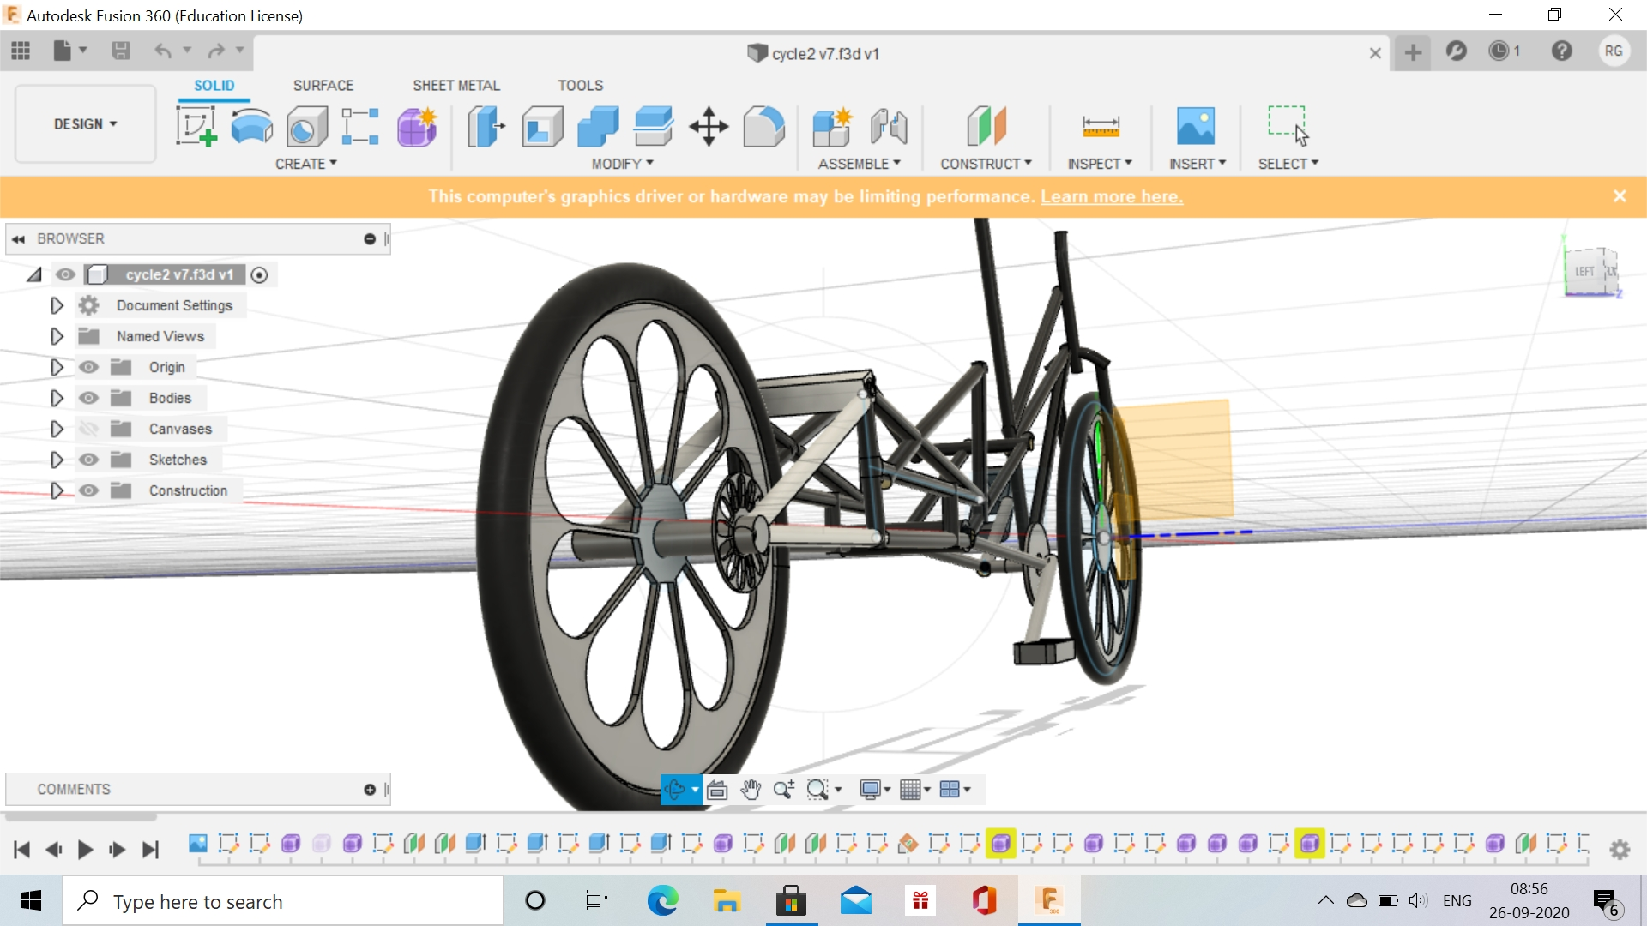
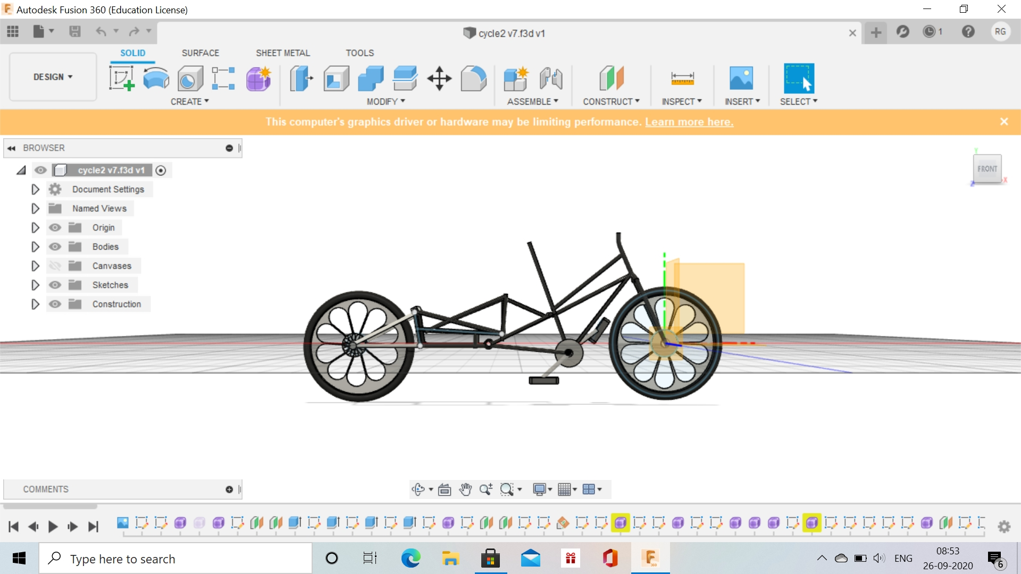
DESIGN OF MODIFIED CARGO BICYCLE

Slide 11
Wheels | 28”
Weight | 18kg
Folded size | 185cm | 72”
Total size | 255cm | 100”
Trolley dimensions | Length- 75cm , width – 43cm
Frame size | One size
Suggested rider height | 158cm-195cm | 5’2”-6’5”
Max rider weight | 120kg
Loads capacity | 60kg

Slide 12
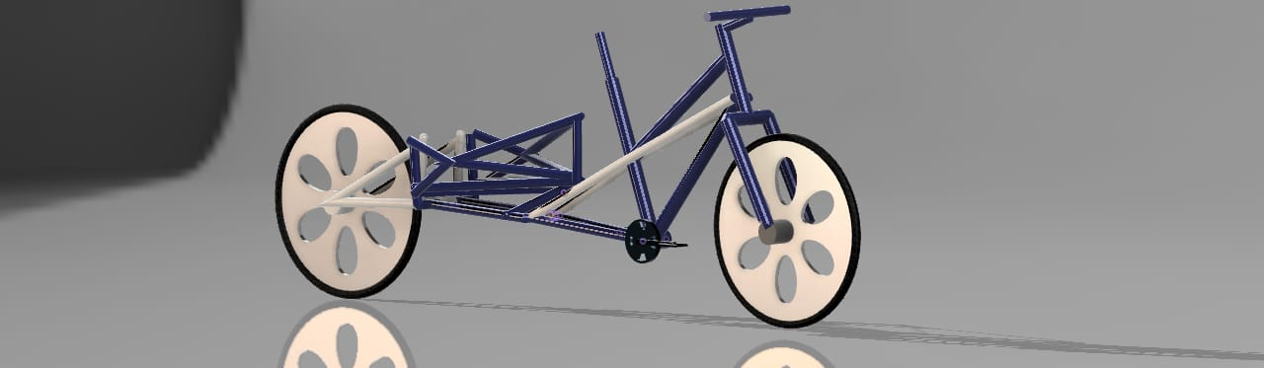
RENDERING

Slide 13
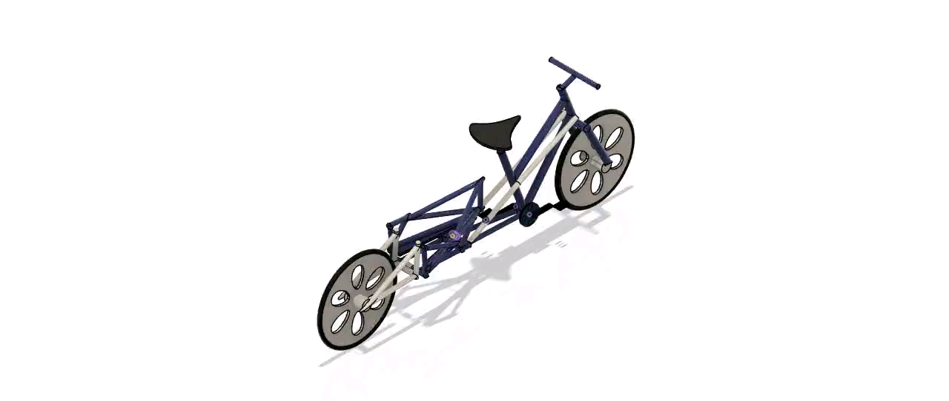
SIMULATION/ANIMATION

Slide 14
MATERIAL SELECTION
Property Chart
Materials | Modulus of Elasticity | Yield Strength | Poissions Ratio | Density | Cost
 | (Gpa) | (Mpa) |  | (g/cm^3) | (% to relative cost)
AA 7075 T6 | 70 | 480 | 0.32 | 3 | 10
AA 6061 T6 | 69 | 270 | 0.33 | 2.7 | 9.5
AA 8090 T8151 | 68 | 210 | 0.33 | 2.7 | 9.5
AA2219 T87 | 72 | 390 | 0.33 | 3.1 | 11
cast aluminium(alu aisi 10 mg) | 71 | 230 | 0.33 | 2.6 | 9.5
Max/Min | 72 | 480 | 0.33 | 2.6 | 9.5
Scale Value
Materials | Modulus of Elasticity | Yield Strength | Poissions Ratio | Density | Cost
 | (Gpa) | (Mpa) |  | (g/cm^3) | (% to relative cost)
AA 7075 T6 | 97.22222222 | 100 | 96.96969697 | 86.66666667 | 95
AA 6061 T6 | 95.83333333 | 56.25 | 100 | 96.2962963 | 100
AA 8090 T8151 | 94.44444444 | 43.75 | 100 | 96.2962963 | 100
AA2219 T87 | 100 | 81.25 | 100 | 83.87096774 | 86.36363636
cast aluminium(alu aisi 10 mg) | 98.61111111 | 47.91666667 | 100 | 100 | 100
Weighing factor | 0.25 | 0.416666667 | 0.083333333 | 0.083333333 | 0.166666667
Performance Index
AA 7075 T6 | 97.10858586
AA 6061 T6 | 80.42052469
AA 8090 T8151 | 74.86496914
AA2219 T87 | 88.57068671
cast aluminium(alu aisi 10 mg) | 77.95138889

Slide 15
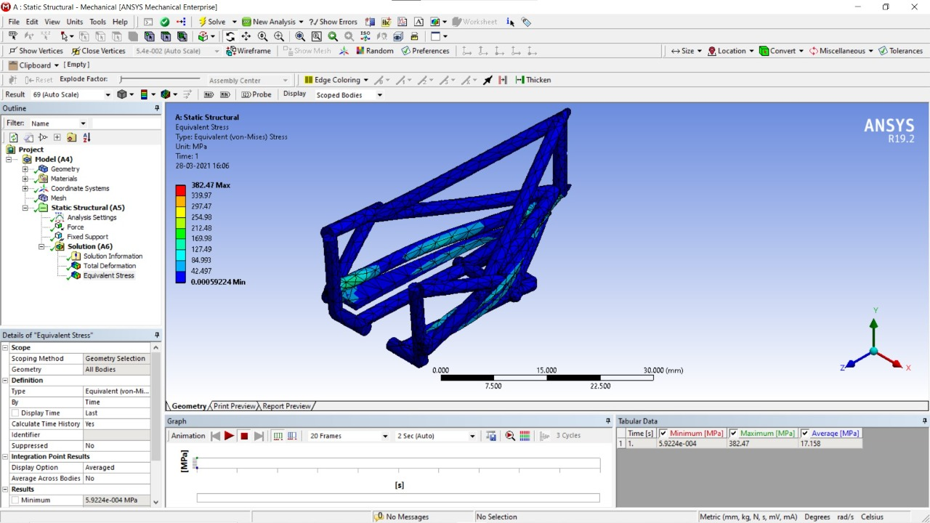
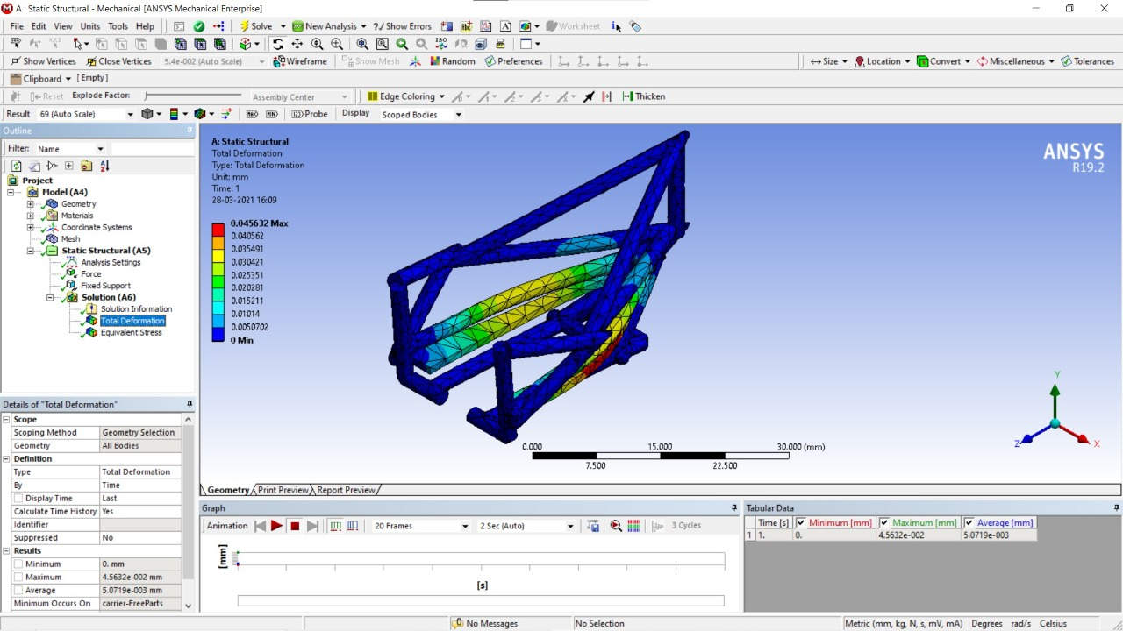
Design No 1 : STATIC ANALYSIS
Deformation : 0.045632 mm
Yield stress : 382.47 Mpa
Applied load = 588.6 N

Slide 16
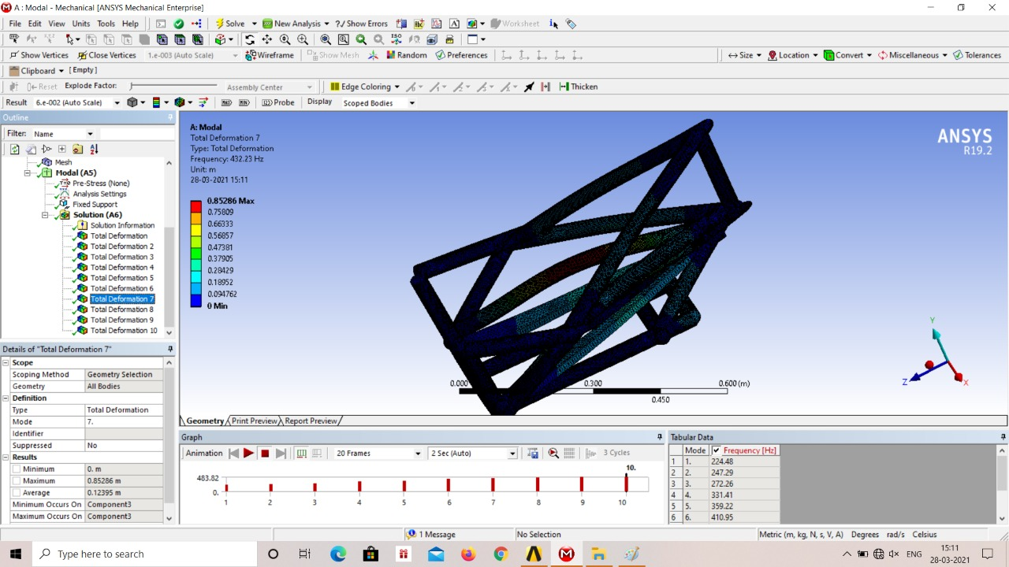
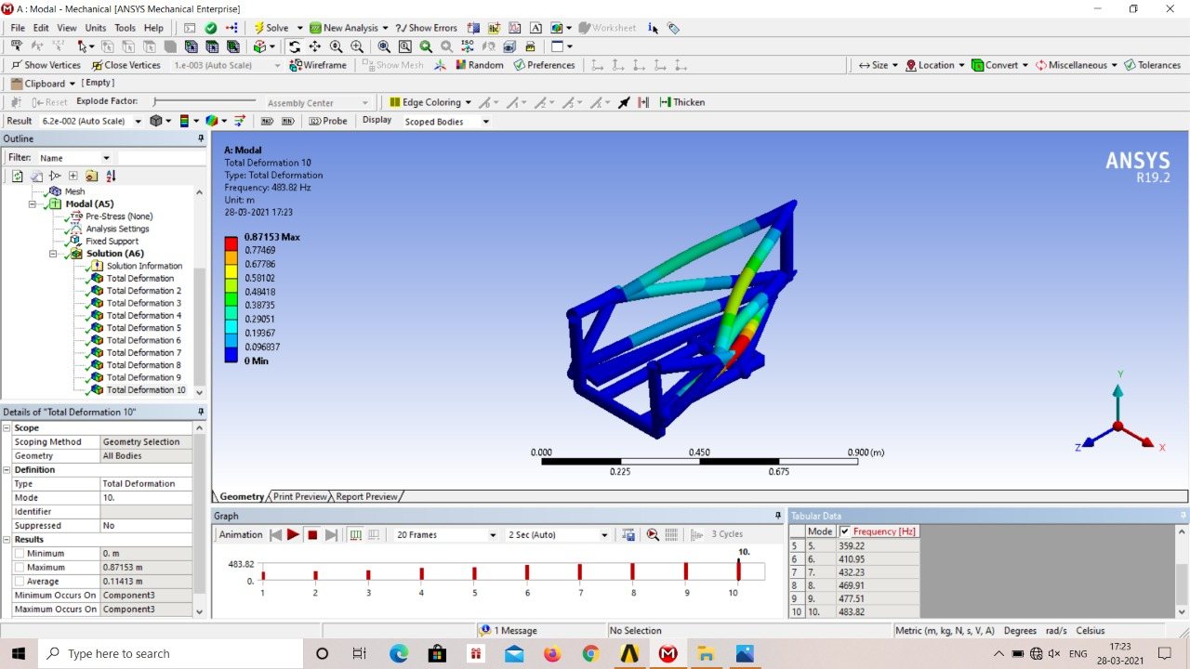
MODAL ANALYSIS
Maximum Frequency : 483.82 Hz
Deformation : 0.85286 mm

Slide 17
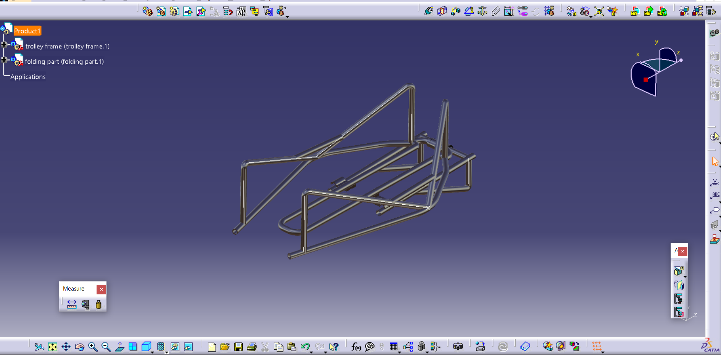
Modified Design : STATIC ANALYSIS
Material : Aluminium 7075 T6

Slide 18
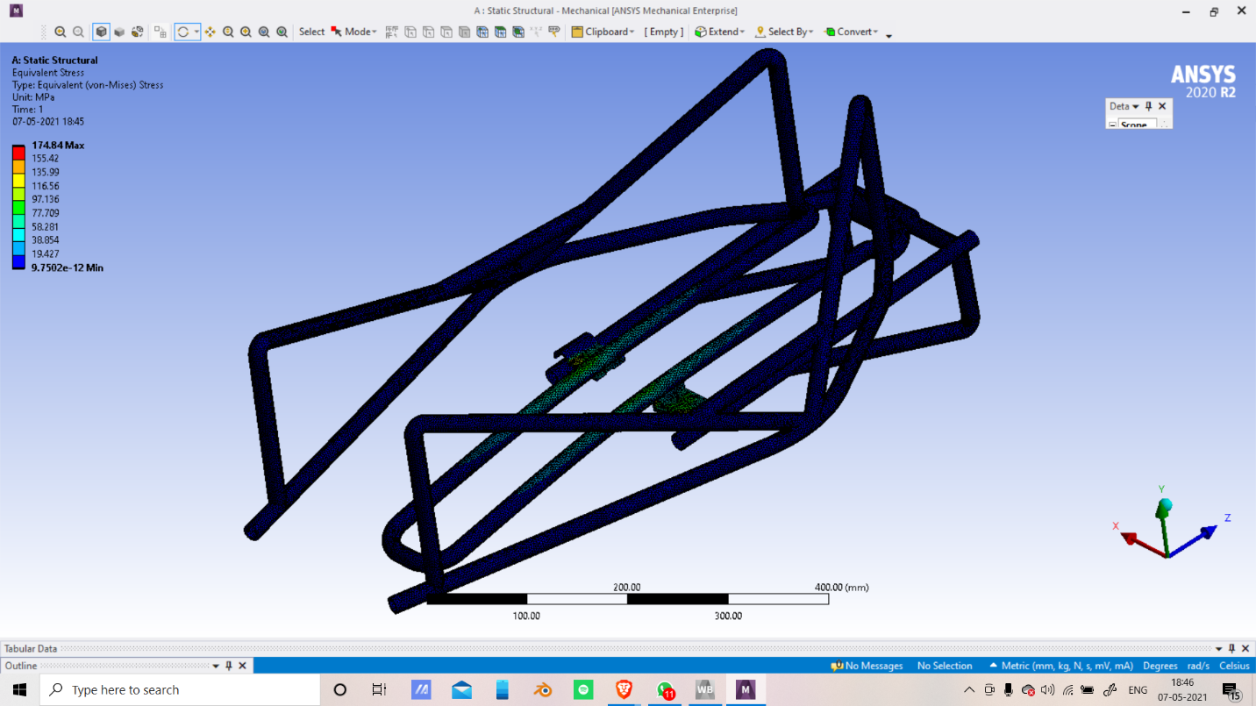
Design No 2 : STATIC ANALYSIS
Yield Stress = 175 Mpa
Applied Load = 1000 N

Slide 19
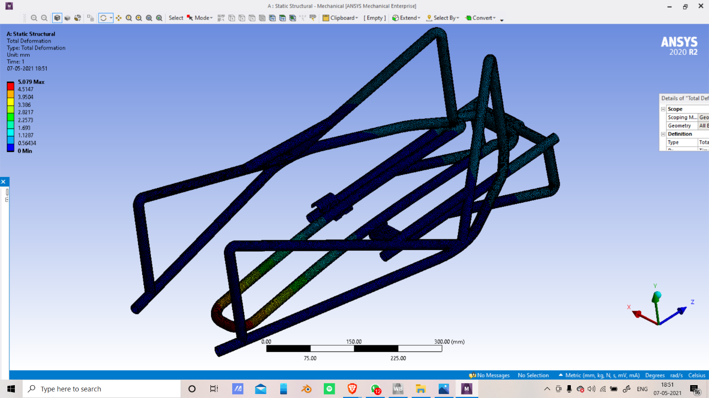
Deformation
Deformation : 5 mm
Sr no. | Force (N) | Stress (Mpa) | Deformation (mm) | F.O.S
1 | 588.6 | 382.5 | 0.05 | 1.3
2 | 1000 | 175 | 5 | 2.4

Slide 20
Calculation of Impact Force on Traulley
By Impulse- Momentum Theorem ,
P = F _{impact *} Delta T
F_{impact} = P / Delta T
Momentum generated of vehicles at top speed ,
P = m*V
P = 60 ( Kg) * 6.5 (m/s)
P = 39 Kg m/s
Hence , F_{impact} = 39 / 0.1
F_{impact} = 390 N

Slide 21
ADVANTAGE
It reduces delivery service vans that would yield in better road network efficiency and reduce wheel to wheel (co2) emission and increases delivery reliability
A convertible tray has low cost of operations.
Less maintenance cost.
Easy to carry since it is portable
Time saved finding parking because it can park on sidewalks
Money saved on parking tickets
Improved road safety for pedestrians and cyclist as bicycle collions are less sever than collisions with a delivery truck

Slide 22
LIMITATIONS
It will be difficult to climb steep slopes
Road regulations ( cargo bicycles are illegal in new york city)
Limited bicycle infrastructure
Driver fatigue
Not effective in extreme weather conditions
Collisions may be more severe for the cargo cyclist as compared to driver in truck

Slide 23
APPLICATION
Cargo bicycles used for delivery service in dense urban environments
Food vending in high foot traffic areas
Also able to work or provide service as a mini transport vehicle

Slide 24
RESEARCH PAPER
Research paper printed in Journel | Sustainable city logistics- Making cargo cycles viable for urban freight transport Gabriele Schliwa, Richard Armitage, Sara Aziz, James Evans, Jasmine Rhoades http://dx.doi.org/10.1016/j.rtbm.2015.02.001
Research paper printed in Journel | Design and Operation of an Urban Electric Courier Cargo Bike System-Tanja neils, Moritz travis hof, Klaus bogenberger https://10.1016/j.trpro.2019.06.038
Research paper printed in Journel | Design and development of modern electric bike ISSN: 2278-0181 Vol. 9 Issue 11
Research paper printed in Journel | Design and Fabrication of Detachable Cargo Bicycle Trolley cum Hand Truck ISSN (online): 2349-784XVolume 4 | Issue 10

Slide 25
CONCLUSION
After explaining the concept of our project i.E modification in cargo bicycle ,
We conclude that , it is latest and one of the best modification in cargo bicycle , which is made in order to reduce the length(size) of the cargo bicycle by keeping the weight sustainable or loading capacity as it is
Also it is modification because in this we are making the compact and convertible model of the cargo bicycle , that’s why we called it , convertible cargo bicycle
This project step towards to research on the environment friendly transportation.

Slide 26
Thank You !

